Slide 1
Introduction to MRI in cognitive neuroscience

Slide 2
Analysis steps (most modalities modalities)
First-level analysis
Group analysis
Multiple comparison correction
Preprocessing
Compensating for artifacts
Correcting for subject movement
Normalization (mapping to template space)
Smoothing: increases SNR
Deriving some subject-level measures (aka dependent variables), e.g. thickness, activation, connectivity, FA
Analysis of your subject sample, e.g. comparison of within-subject conditions, group comparison, regression/correlation with behavior
Compensating for alpha error (false positives) inflation due to many dependent variables: n voxels, n tracts, n connections, etc.

Slide 3
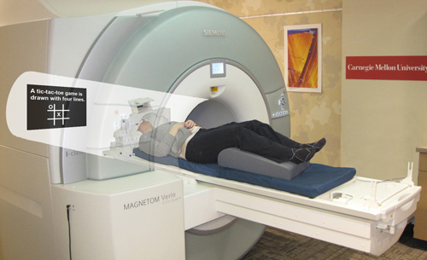
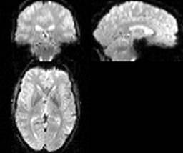
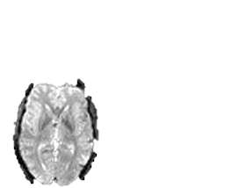
Motion correction/coregistration
Purpose: compensate for subject movement
Notes:
One of the first preoprocessign steps is motion correction.
Why do we need motion correction?
During the fMRI experiment the subject is supposed to lay still inside the scanner, and they usually do so.
However, even your best volunteer won’t be perfect. And in fMRI, even a frew millimeters screw up your experiemnt.
Here is an example. Let’s say we are measuring a voxel located on the left hemishere, and the subject suddently moved.
As a result, the same voxel will be now recording activity from the empty space between the hemispheres, or even form the opposite hemisphere.

Slide 4
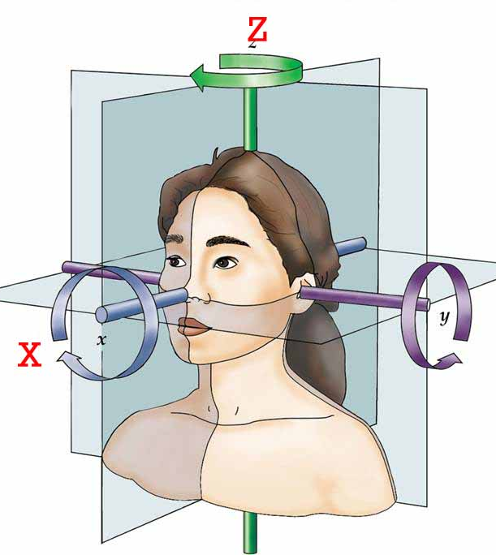
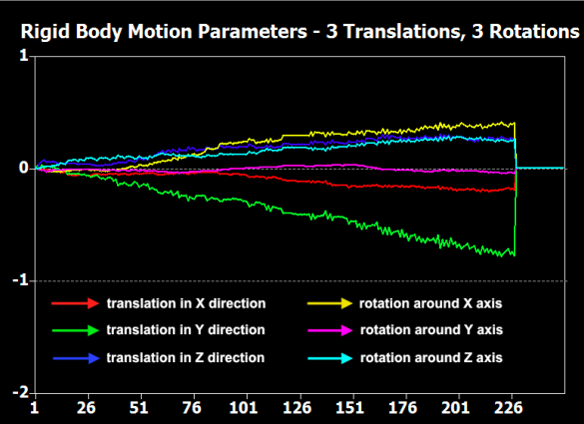
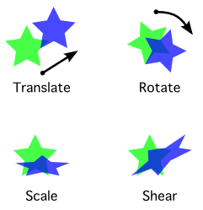
Motion correction
Purpose: compensate for subject movement
6 parameter “rigid body” transform
3x
3x
# volume
Notes:
Usually, motion is much smaller, but we still want to correct it.
How do we do this? Luckily there are special angorythms that can estimate the amoutnt of motion from one volume to the next.
This is usally done using 6 degrees of freedom: trhasnlation in x, y, and z and rotation in x, y, and z. This is called the rigid body transform, because you do not change the size and shape of the volume, but simply rotate it in space.
After the amount of motion has been calculated, it can be applied to every image to align it back to the necessary position.

Slide 5
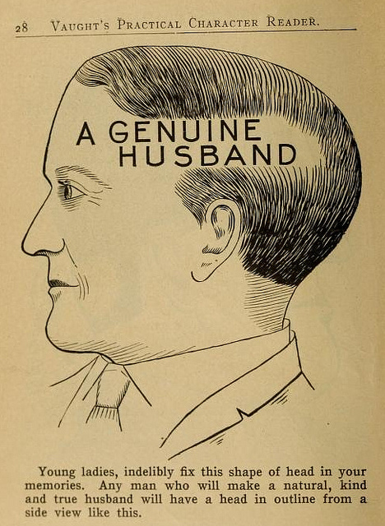
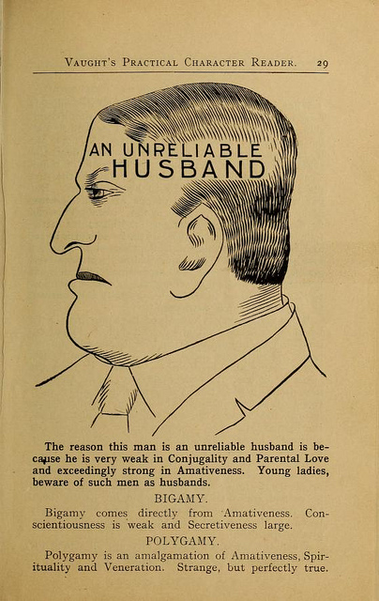
“Normalization” to common space
Purpose 1: compensate individual differences in brain shape for the group analysis
http://publicdomainreview.org/collections/phrenology-diagrams-from-vaughts-practical-character-reader-1902/
Notes:
Finally, if you are preforming a group study, you also need to map each individual subject into some common space.
This is not a trivial task.
As head shpaes of people are different, there brain shapes are also different.
Here I tried to draw the approximate shape if each of these guy’s brains, and some hypotheitcal template brain.

Slide 6
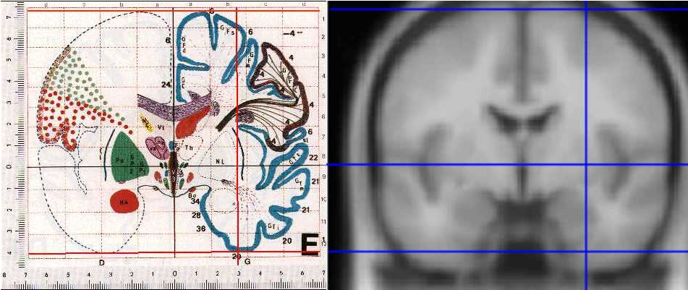
Templates & coordinate systems
Purpose 2: Unified coordinate system
Talairach
MNI
http://imaging.mrc-cbu.cam.ac.uk/imaging/MniTalairach

Slide 7
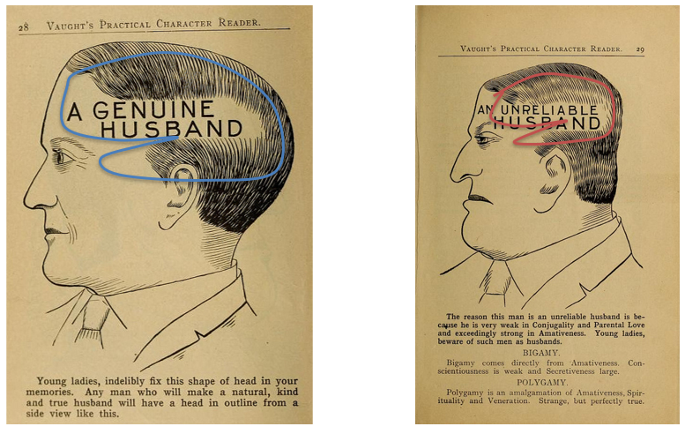
Rigid transform
Template
6 parameter rigid transform
3x
3x
Notes:
To match each of them to the template, it is not enough to coregister them as we did for motion correction, because obviously they are of different sizes

Slide 8
Affine transform
12 parameter affine transform
3x
3x
3x
3x
Notes:
We can add 6 more paraeters to the transform, which compensates does scaling and shearing, to better align them.
However, there will still be places wehere they do not align perfectly, because one guy one has a bigger frontal lobe, and gy to a bigger parietal lobe

Slide 9
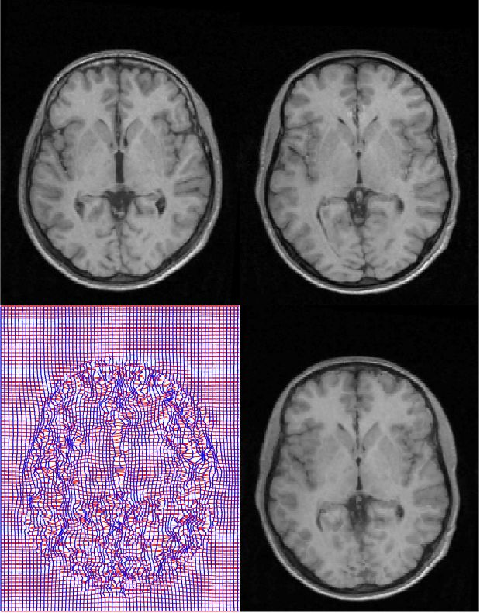
Nonlinear transform
Source
Template
“warping”
Deformation field
Warped image
Notes:
So some software packages use a nonlinear warping algorythm to align brains. There you have to estimate a 3D deformation field and then nonlinearly warp each brain onto a template. They are called non-linear, because different parts of the volume are scaled differently.

Slide 10
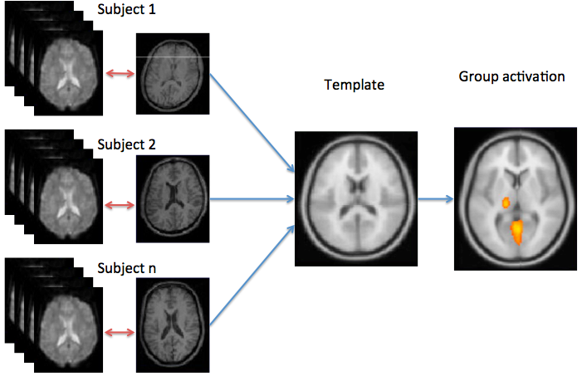
Normalization is usually done using a structural scan
Notes:
The mapping to common space is usally done via an anatomical scan. First, each subject functional and anatomical scans are coregistered with each other, and then each subject’s anatomical scan is mapped into a template. This is done because the anatomical scan has better quality, and hence the estimated transform is more preceise.
After you have done that each area in one subject corresponds to the same area in the other subject and you can perform averaging on them.

Slide 11
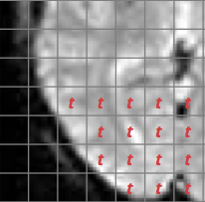
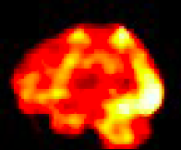
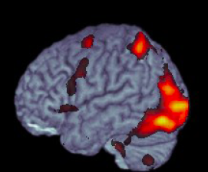
Multiple comparison correction
Voxel-wise t-statistic
3D t-statistic map
Final result
t = β/SE(β)
72,221 voxels
Thresholding:
deal with the multiple comparison problem!
Notes:
How do we get from beta estimates to making statistical inference? Rejecting the null hypothesis?
The good thing is that beta estimated devided by its standard eroor is a t-statistic with a t-distribution. So to know wheter an activation in one voxel is significant is relatively straifhtforward.
If we had just one voxel, we would have computed the t-statistic, and then depending on the degrees of freedom determined if it exceeds the critical value.
However, we are doing the same statistical test for MANY voxels. SO the probability that we find a significant voxel simply by chance increases. This is the multiple comparison problem that is encountered anywhere in statistics. In fMRI it is particularly prominent, because the number if singe tests is enormous.
There are several ways and philosophies for dealign with it, I won’t go into details right now. The important thing is that any voxel wise analysis MUST deal with this problem in some way.

Slide 12
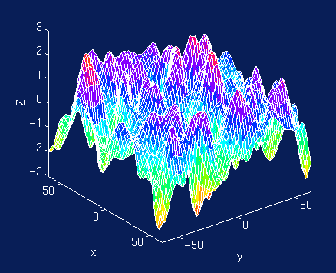
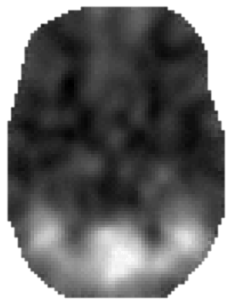
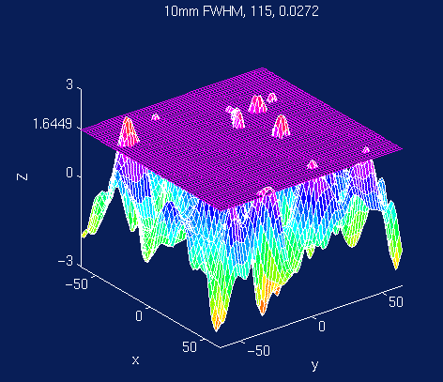
SPM: Family-Wise Error (FWE)
SPM{t}
“soft” Bonferroni correction
Based on Gaussian Random Field Theory
Assumes spatial Gaussian distribution voxel values
Threshold adjustment controls the probability (e.g. p<0.05 ) of false positive blobs (“resels”) instead of false positive voxels
For some more maths and explanations see:
http://imaging.mrc-cbu.cam.ac.uk/imaging/PrinciplesRandomFields#The_multiple_comparison_problem
Notes:
Determine n resels (related to smoothness, Smoothness is determined from the covariance of the residulas (remaining signal that is not modelled in your GLM))
Determine Expected Euler characteristic of an image when thresholded at different levels (EC – roughly number of blobs after thresholding, complicated formula, but depends on the number of resels)
Use Euler characteristic distribution to determine the threshold for required fals-positive probability (e.g. 0.05)
SPM likes to use a method called family-wise error correction;
In principle, it can be viewed as kind of soft bonferronly correciton, but with the way more complicated math gehind it called the gaussian random field theory.
The main idea behind this method is that a value in each voxel is not independent from it’s neigbours. And you can see that it is true, especially when the data has been smoothed, or t-map values vary smoothly across the brain volume.
So instead of figureing out the threshold such that the number of false poistive voxels is kept at a certain leve, e.g. 0.05, it tries to figure out how many false positive blobs you will get.

Slide 13
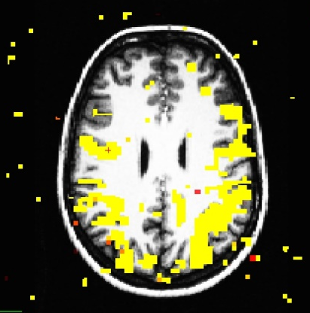
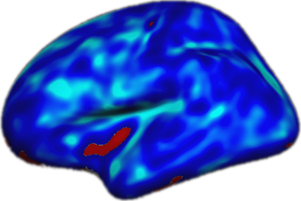
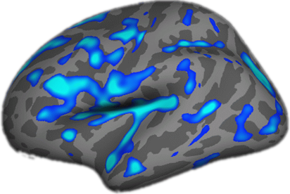
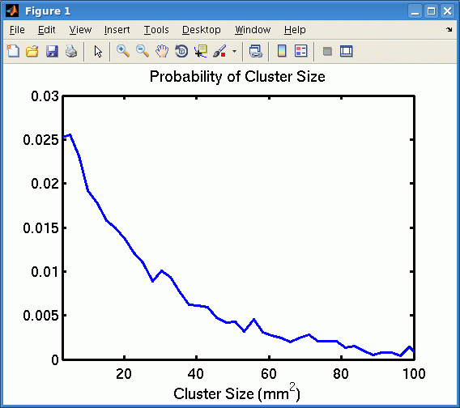
FS-FAST: Montecarlo-based cluster-wise correction
True activations tend to cluster
Threshold a map at some p-value
Generate random noise, analyze it like real data, get maximal cluster size
Repeat many times and get a distribution of maximal cluster sizes observed in noise
Compare each of your real clusters to the distribution
P(cluster) = probability of seeing a maximum cluster of that size or larger in noise
Unthresholded
p<.0001
mri_glmfit-sim
https://surfer.nmr.mgh.harvard.edu/fswiki/FsTutorial/GroupAnalysis#ClusterwiseCorrectionforMultipleComparisons
Notes:
FDR: proportion of false positives rather than probability of AT LEAST ONE false positive

Slide 14
Multiple comparison correction
Avoid it if you can by formulation a specific hypothesis

